Slide 1
电池全生命周期管理系统
结题汇报
Jun 7，2024
小组成员：王浩羽、李宗润、徐 涵
指导老师：卢周广、高 源、宋 轩
企业导师：袁 飞

Slide 2
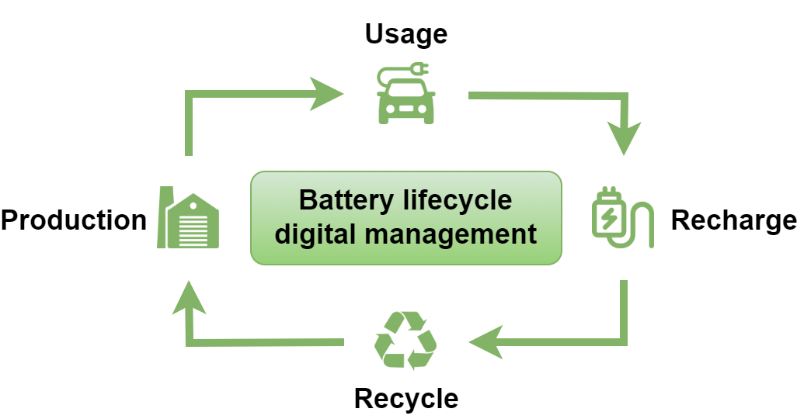

Background
Advantage：
Improve battery performance and safety
Provides support for the secondary utilization of batteries
2 / 45
Notes:
背景和意义的阐述需要清晰的说明项目的why的内容！为什么我们要做这个项目，基于哪些背景需求，解决了这些需求有什么意义，这些意义才是我们科研工作的研究价值。

Slide 3
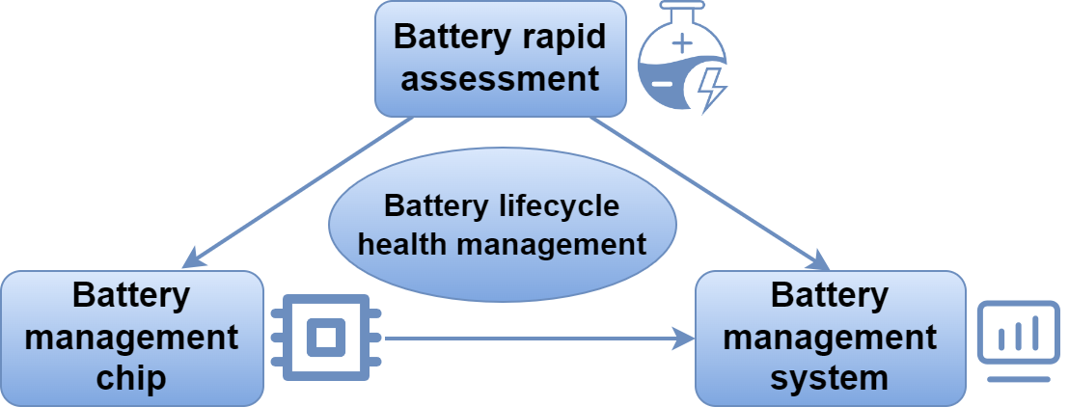
Background
材料科学与工程系
李宗润
深港微电子学院
徐涵
计算机科学与工程系
王浩羽
3 / 45
Notes:
背景和意义的阐述需要清晰的说明项目的why的内容！为什么我们要做这个项目，基于哪些背景需求，解决了这些需求有什么意义，这些意义才是我们科研工作的研究价值。

Slide 4
Part A: Materials Science
and Engineering
Test platform
Test process
Cycle and EIS test
李宗润

Slide 5
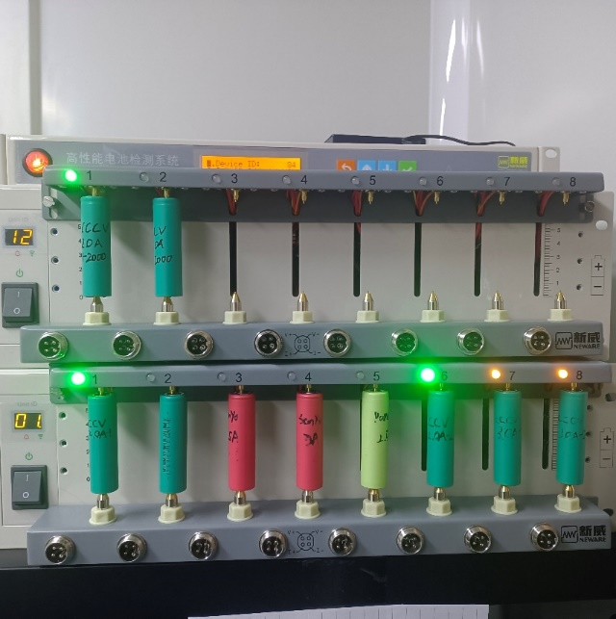
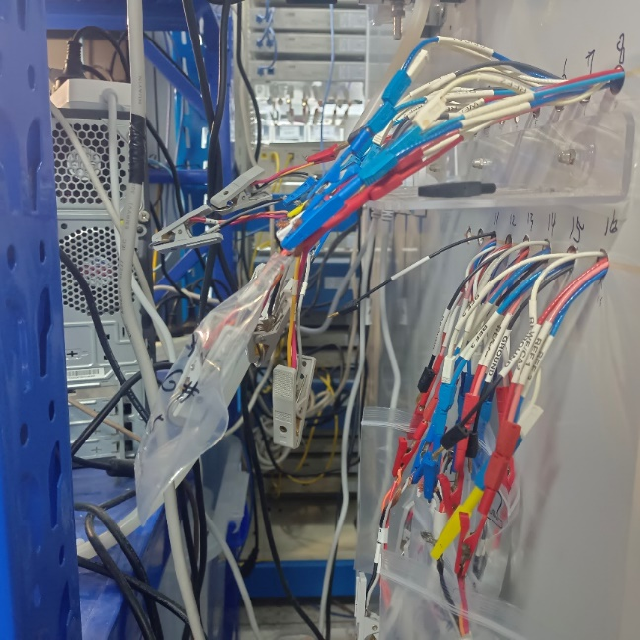
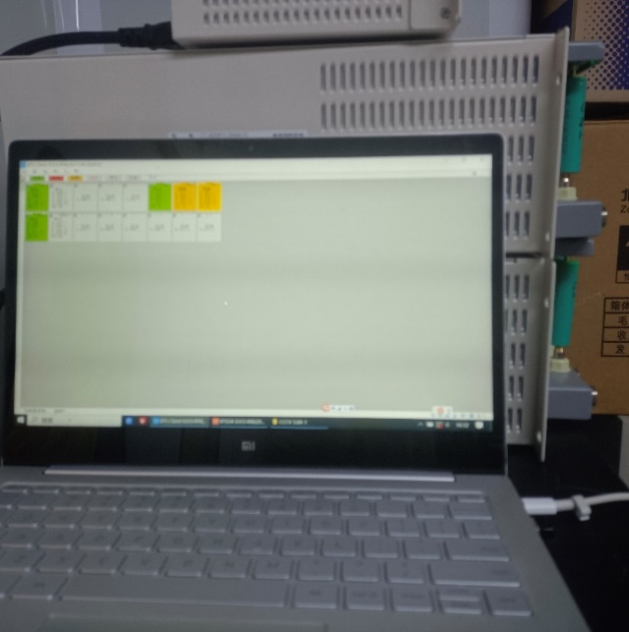
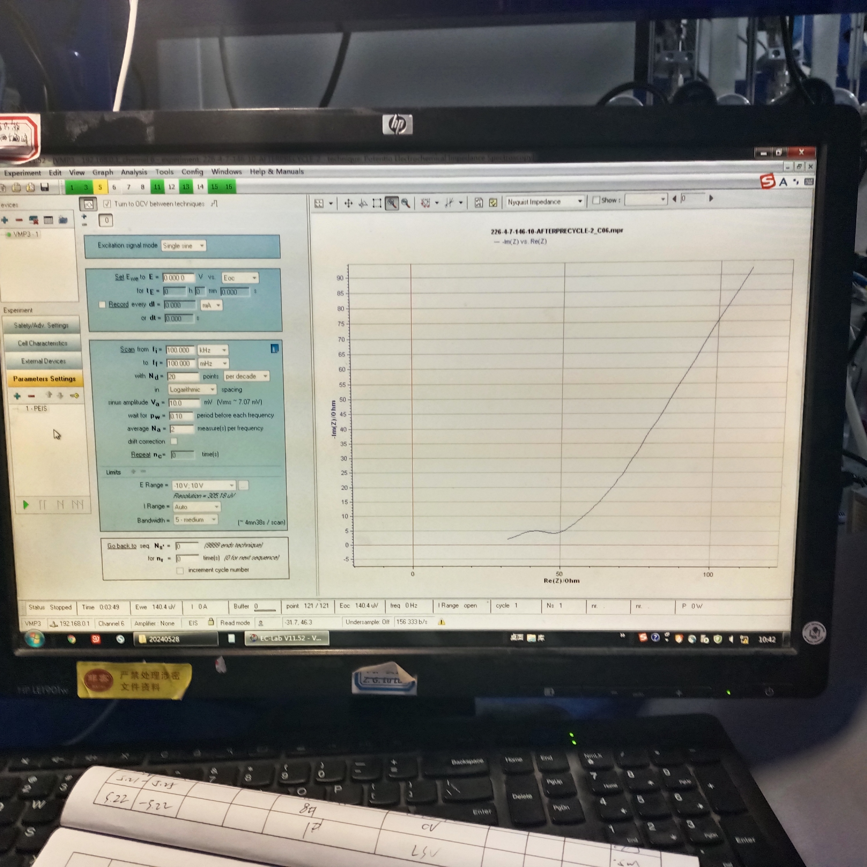
Test platform
Test platform:
Electrochemical Workstation
EIS test platform
Battery：
SANYO&PANA (4.3V)
18650 (4.3V)
Button battery: LIR2032 (3.6V)
Electrochemical Workstation
ElS Test Channel
Control Panel
5 / 45

Slide 6
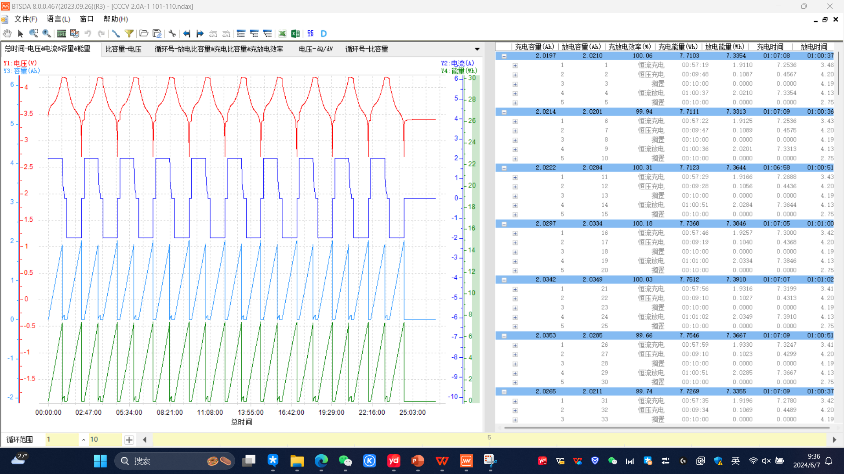
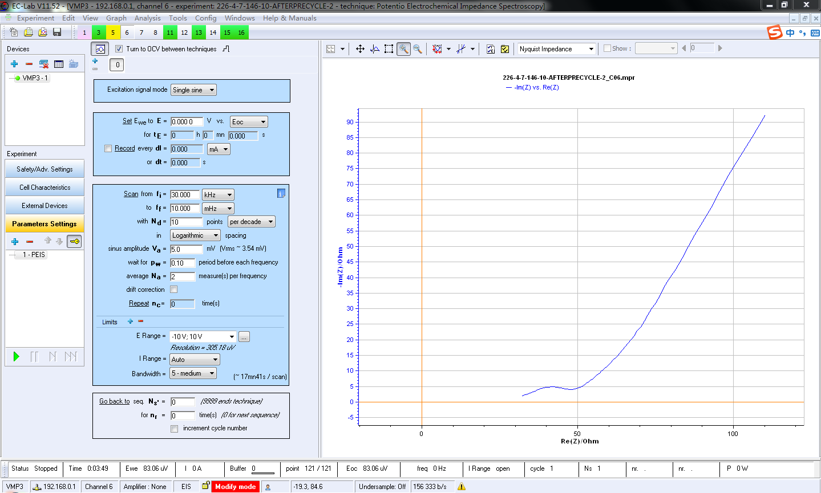
EIS test
BTSDA
EC-LAB
6 / 45

Slide 7
Test process
CC
CV
10 cycles
Record
EIS Test
Rest
Discharge
Record
7 / 45

Slide 8
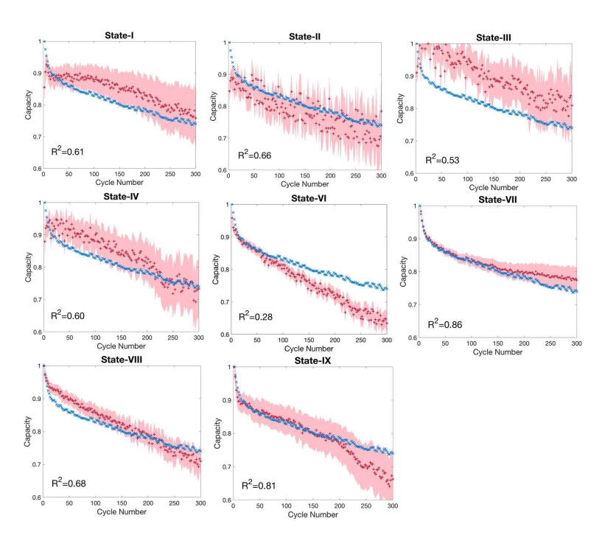
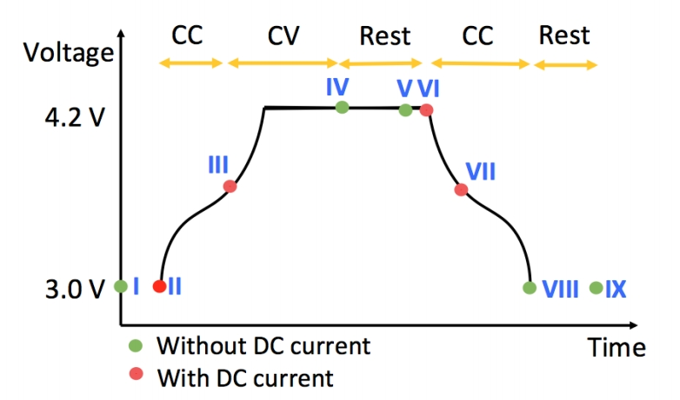
Test process
Data relativity in specific test time：
EIS Measurement States
Fitting Results
8 / 45
Data source: Identifying degradation patterns of lithium ion batteries from impedance spectroscopy using machine learning
https://zenodo.org/records/3633835

Slide 9
Part B:
Microelectronics
Hardware System Design
Data Collect
Data Processing
Compare and Analysis
徐涵

Slide 10
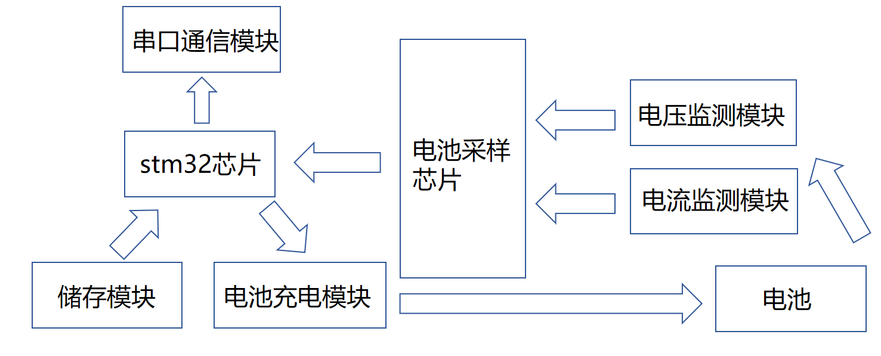
Hardware System Design
Voltage monitor：ADS1115
Current monitor：INA226
Battery charging：PW4035
Serial port communciation：CH340
Storage module：W25Q64
Objective: To measure the complete charge and discharge curve of the battery
Work: Set up the hardware circuit to charge and discharge the battery and sample the voltage and current
10 / 45

Slide 11
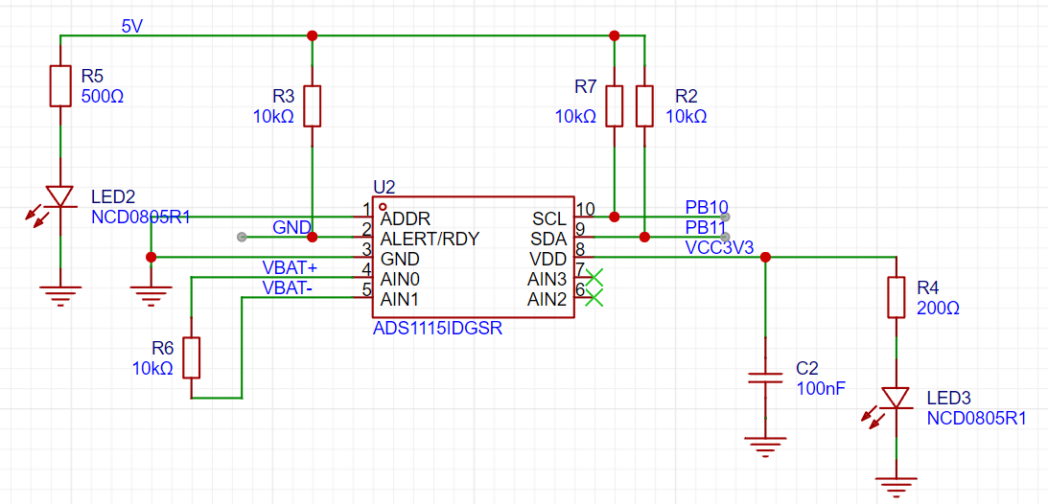
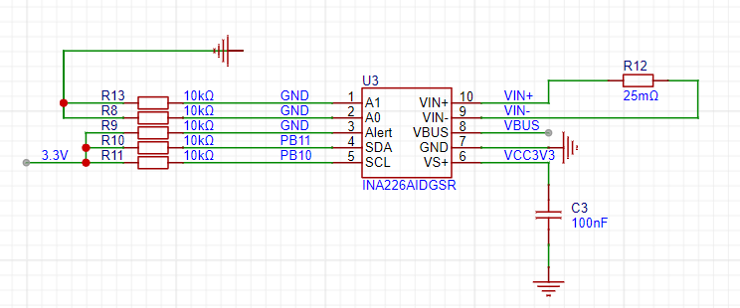
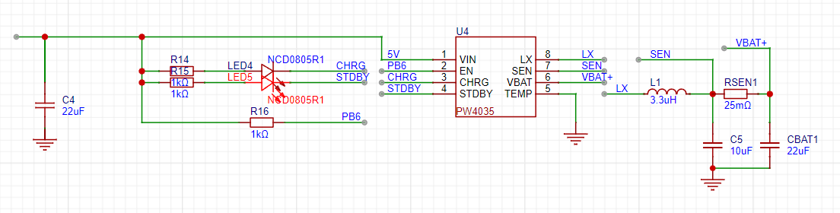
Schematic
Cuttent monitor：INA226
range：3.2A
LSB：0.1mA
Voltage monitor
ADS1115
range：6.144V
LSB：187.5uV
Battery charging：
PW4035
MAX current up to2A
constant current and constant voltage
11 / 45

Slide 12
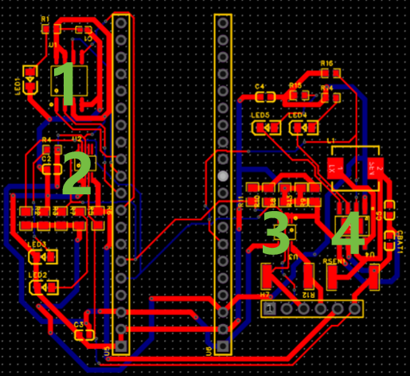
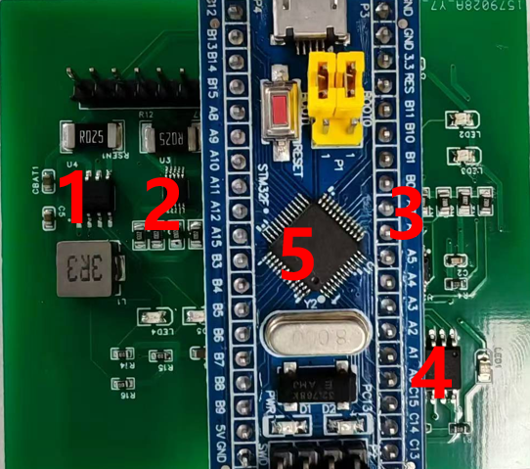
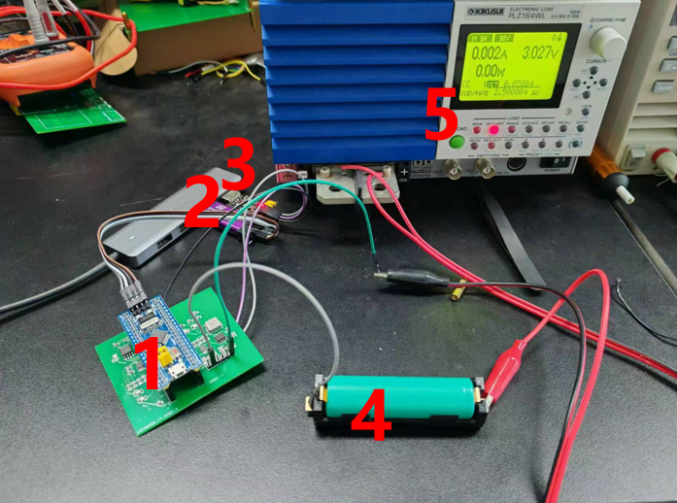
PCB
PCB
Real part
Test
1：W25Q64
2：ADS1115
3：INA226
4：PW4035
1：PW4035
2：INA226
3: ADS1115
4：W25Q64
5：STM32
1：PCB
2：STLINK
3: CH340
4：Battert
5：electronic device
12 / 45

Slide 13
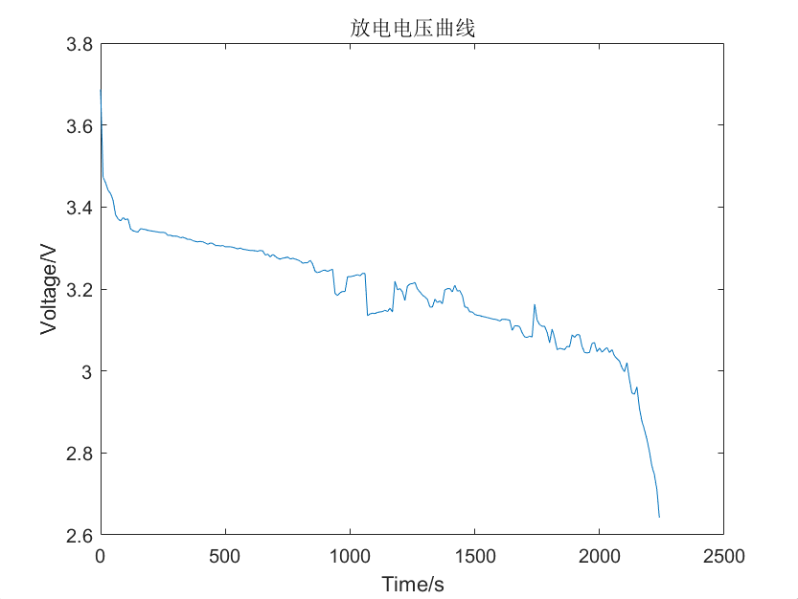
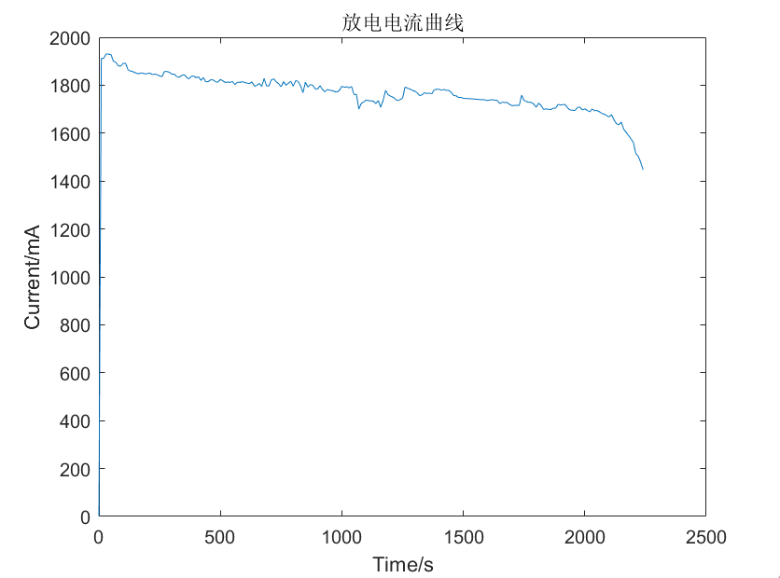
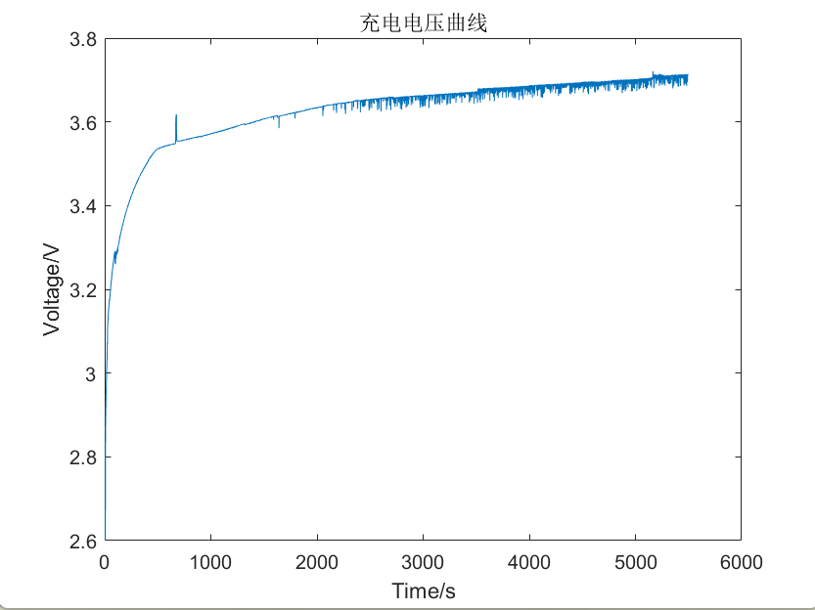
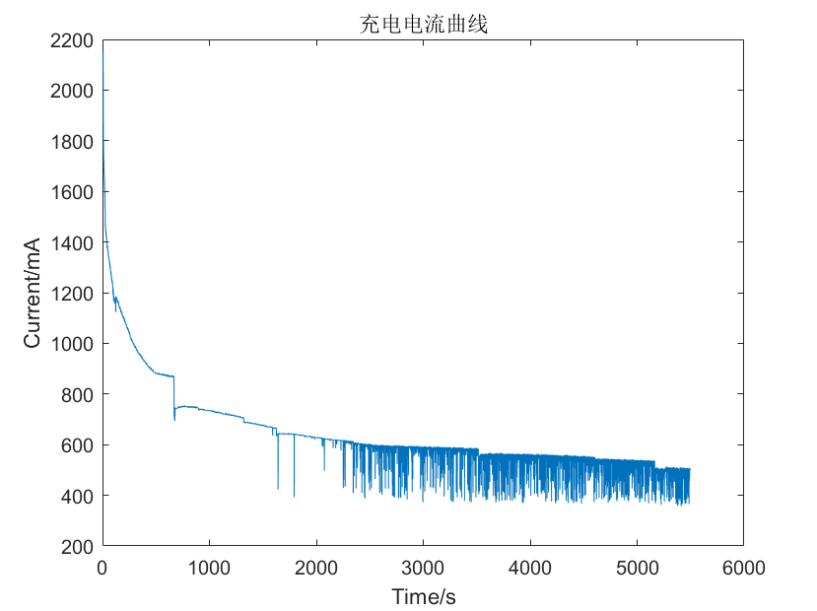
Data Collect
discharge voltage
discharge current
discharge curve
2A discharge
charge voltage
charge current
charge curve
13 / 45

Slide 14
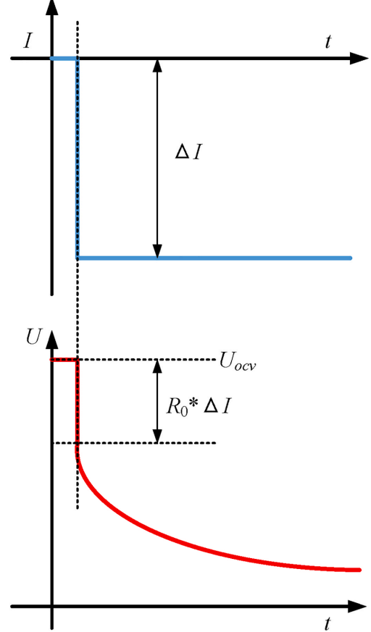
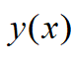
Date processing
discharge--EIS
impedance Z：
exponential decay
discharge
dZ：
；
DRT：
EIS
14 / 45

Slide 15
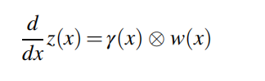
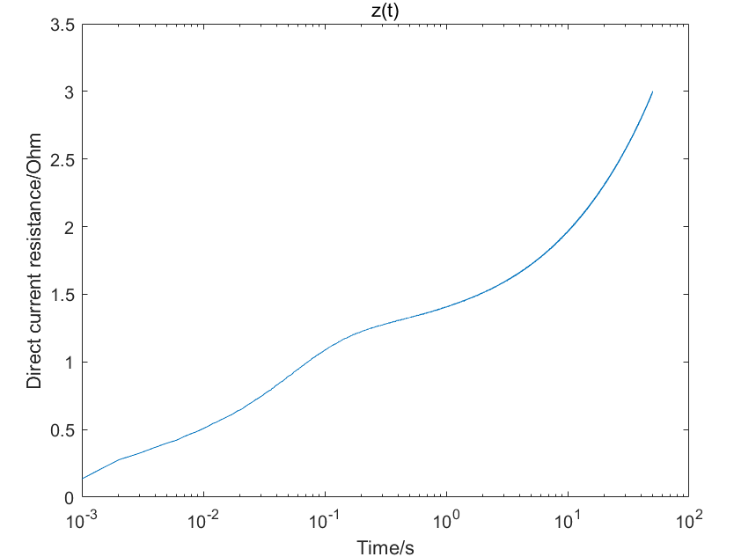
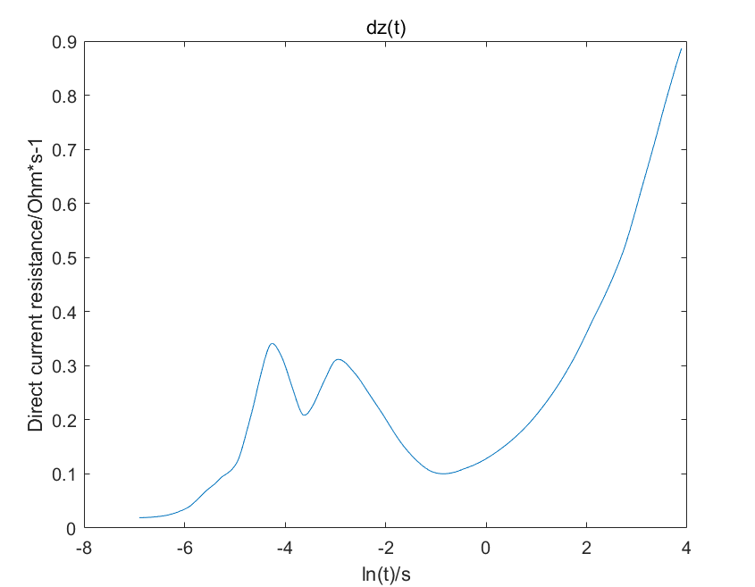
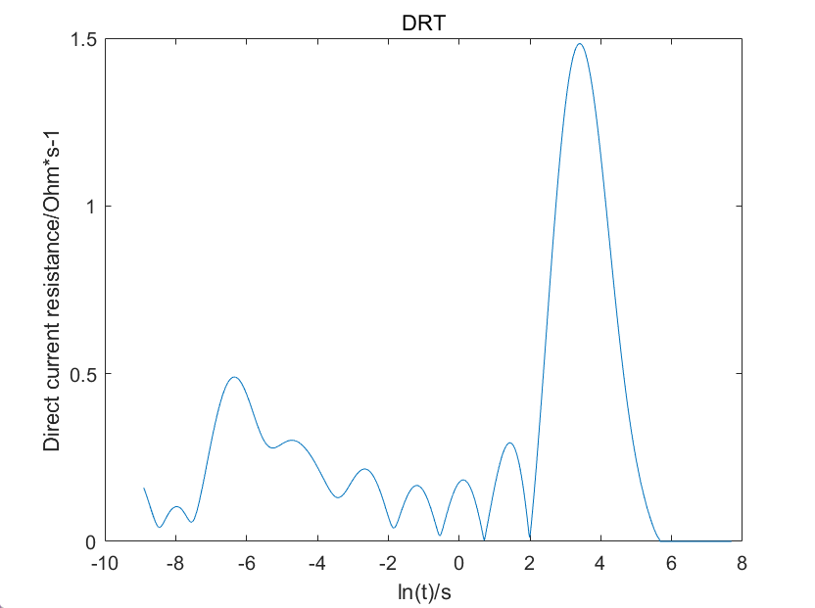
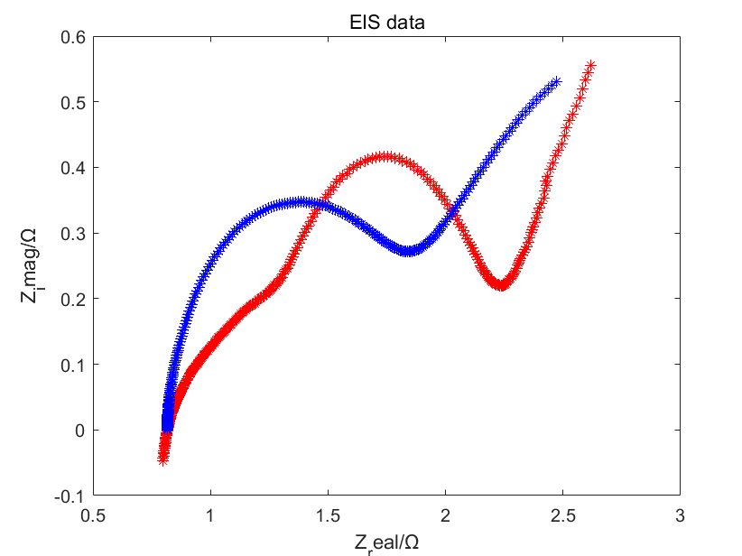
数据处理
discharge--EIS
0.001S sample frequency
50S sample time
Z：
Z
dZ
DRT
EIS
red: real EIS
blue: calculated EIS
15 / 45

Slide 16
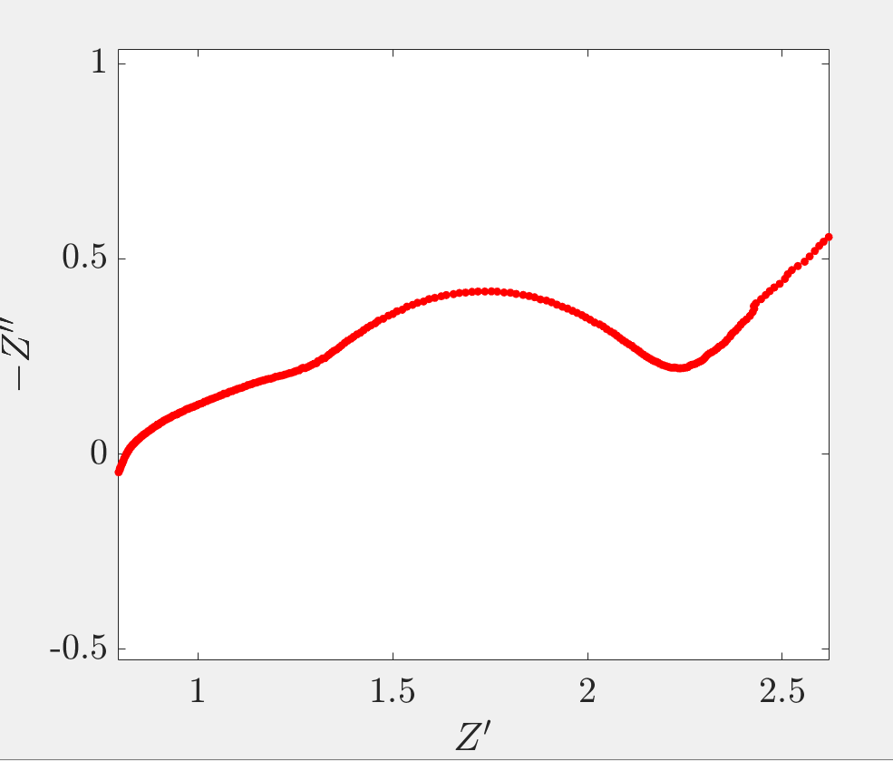
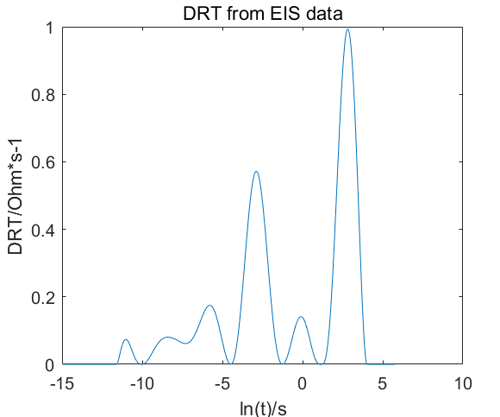
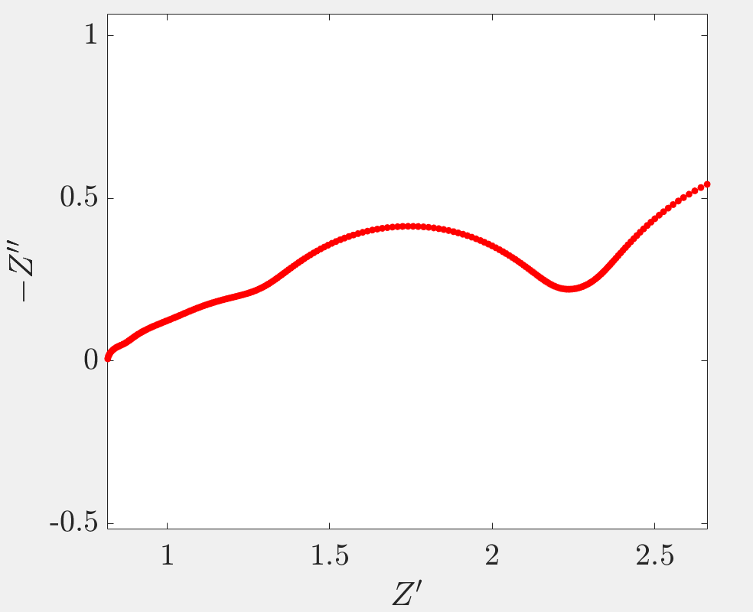
reverse：DRT→EIS
EIS（device）
DRT-tools^{[1]}
DRT
similarity ：
EIS and EIS（from DRT）
calculation correct
EIS（EIS-DRT-EIS）
16 / 45

Slide 17
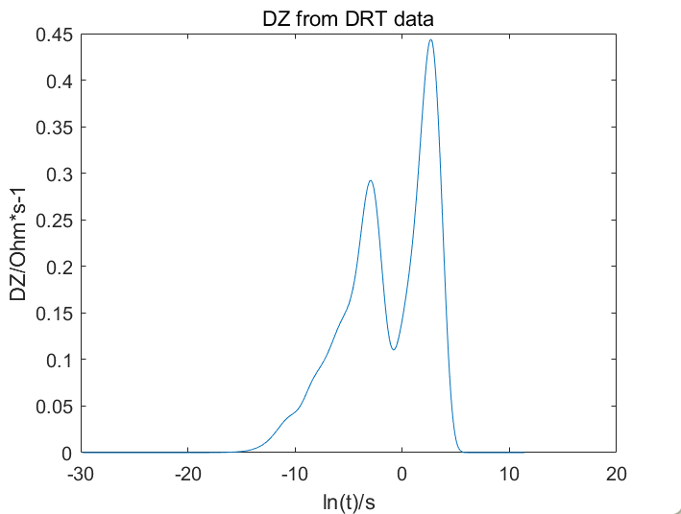
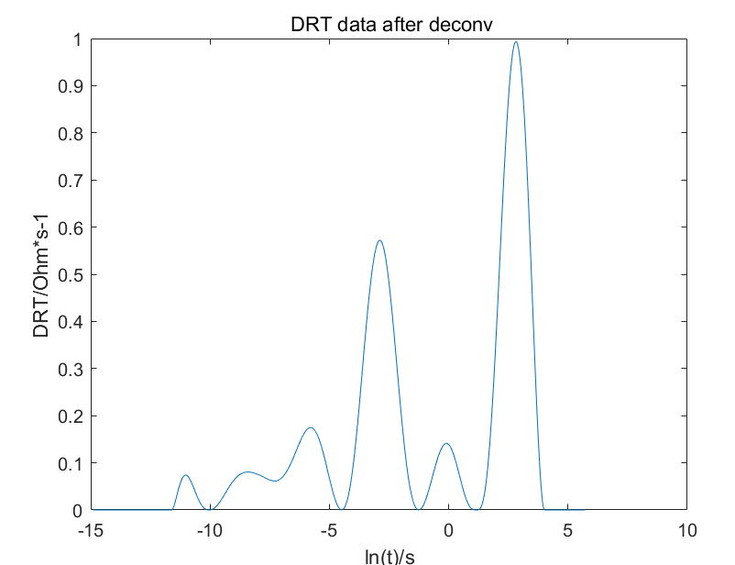
reverse：dZ→DRT
DRT（from EIS）
dZ
similarity ：
DRT and DRT（from dZ）
calculation correct
DRT（DRT-dZ-DRT）
17 / 45

Slide 18
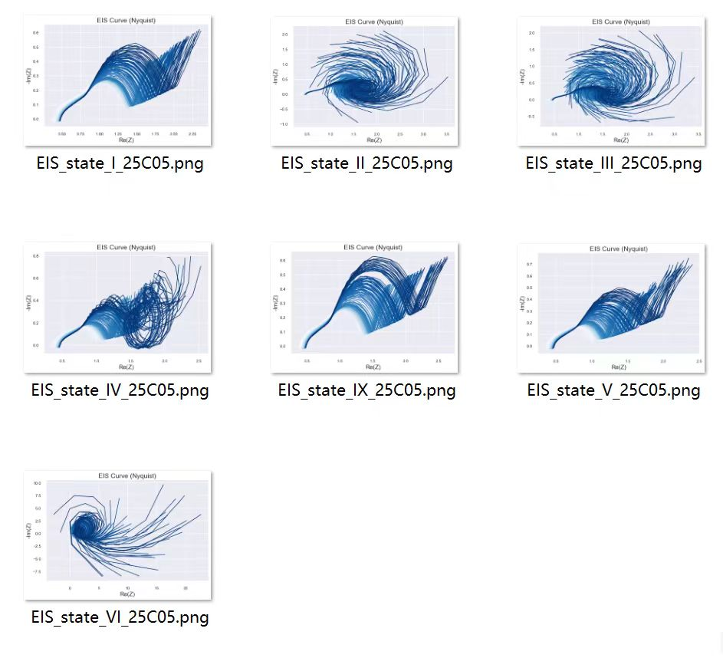
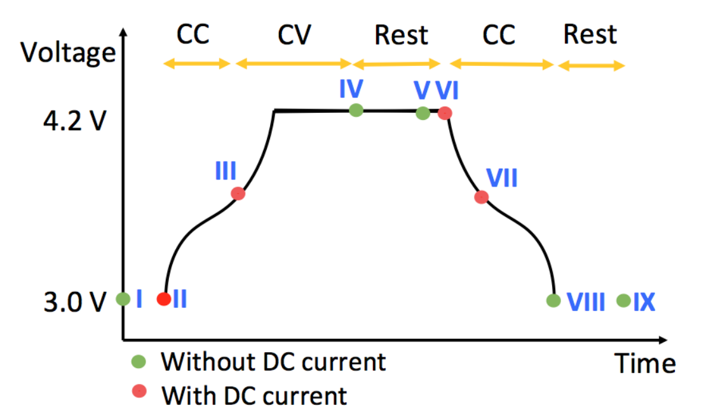
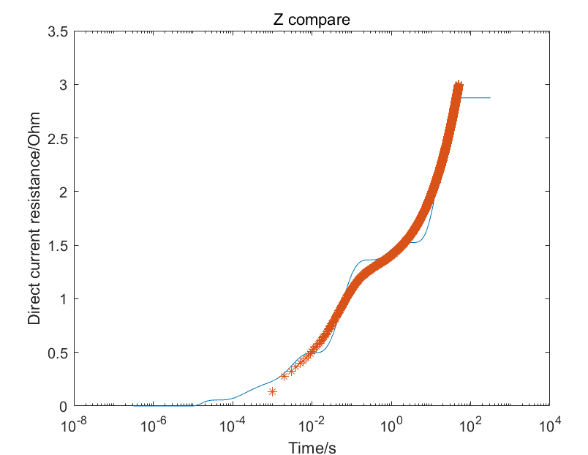
Compare and Analysis
Battery
EIS
Z（compare）
red: Z
blue: reverse Z
correct calculation but incorrect EIS
EIS change on various SOC
Battery cell not enough
Sample frequency not enough（1KHZ vs1MHZ）
18 / 45

Slide 19
Part C: Computer Science
and Engineering
Goals and Objectives
Proposed Methods
Experimental Results
Conclusion
System Demo
王浩羽

Slide 20
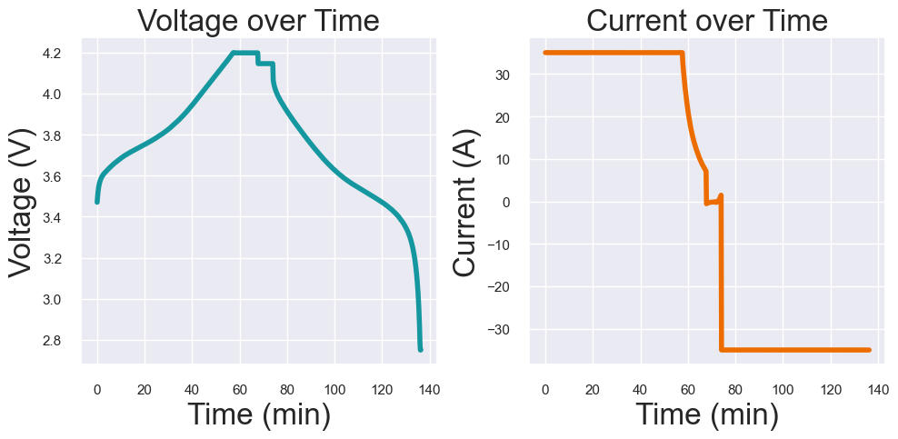
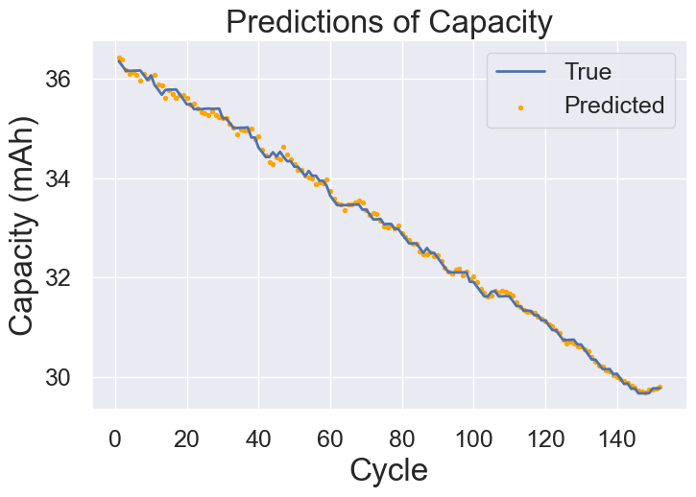
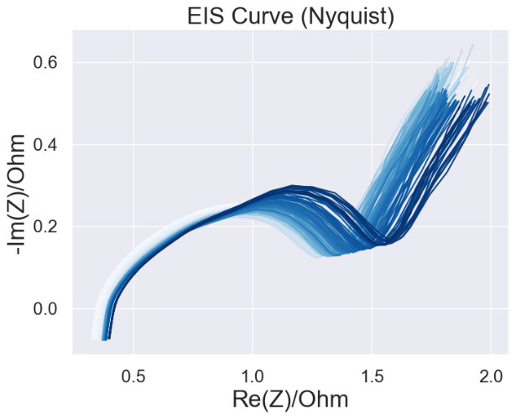
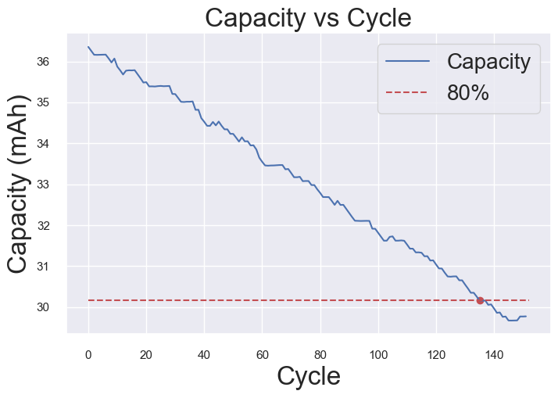
Goals and Objectives
Predict
Charging Curve
Capacity Degradation Curve
Estimate
EIS Profile
Remaining Useful Life (RUL)
20 / 45

Slide 21
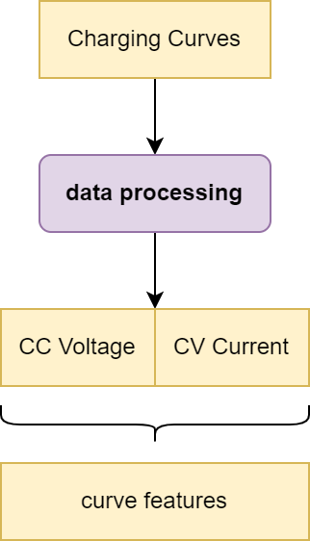
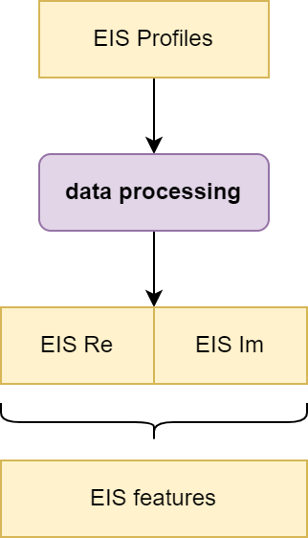
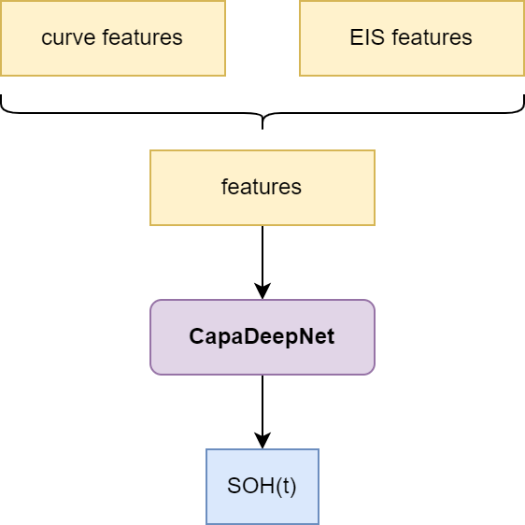
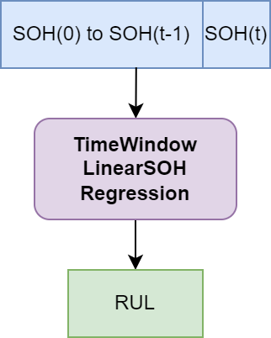
Proposed Methods
Step1
Data Processing
Step2
Predict Current Capacity
Calculate State of Health
(SOH)
Step3
Estimate
Remaining Useful Life
(RUL)
21 / 45

Slide 22
Proposed Methods
Step2: CapaDeepNet
Deep Neural Net for Battery Capacity Prediction
Hyper Params:
Epoch：50
Batch Size：16
DeepNet Structure:
 | layer | in-dim | out-dim
1 | FC | Feature-size | 32
2 | FC | 32 | 64
3 | FC | 64 | 72
4 | FC | 72 | 128
5 | FC | 128 | 64
6 | FC | 64 | 64
7 | FC | 64 | 32
8 | FC | 32 | 16
9 | FC | 16 | 8
10 | FC | 8 | 1
22 / 45

Slide 23
Dataset 1: 18650
Dataset 1 (Self-measuring):
6 Batteries of “18650”
battery | charging protocol | CC current | CV voltage | cycle
1 | CC-CV | 2.0A | 4.2V | 859
2 | CC-CV | 2.0A | 4.2V | 869
3 | CC-CV | 2.0A | 4.2V | 900
4 | CC-CV | 3.0A | 4.2V | 894
5 | CC-CV | 3.0A | 4.2V | 844
6 | CC-CV | 3.0A | 4.2V | 920
23 / 45

Slide 24
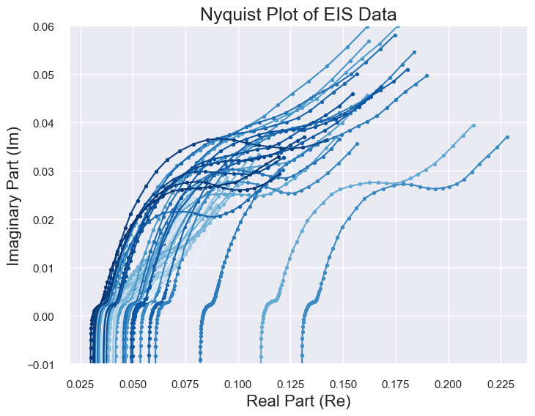
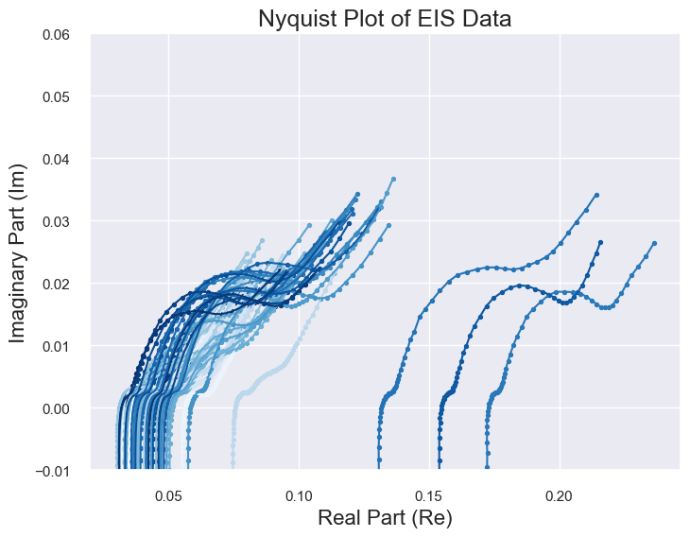
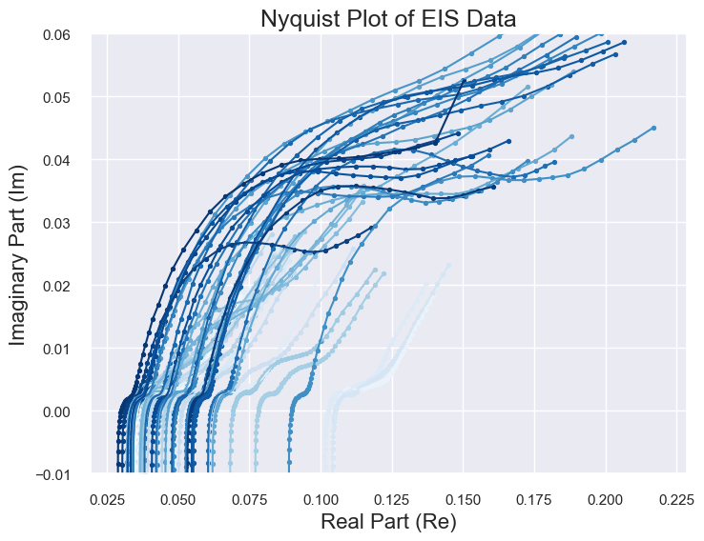
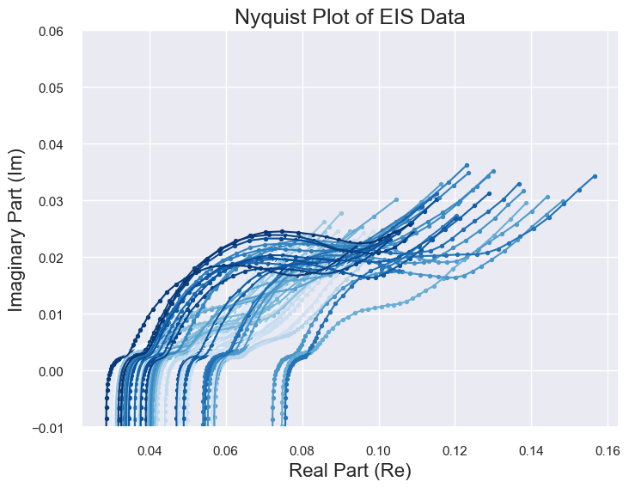
Dataset 1: 18650
EIS Profiles:
Can NOT Use due to
the INSTRUMENTs
24 / 45

Slide 25
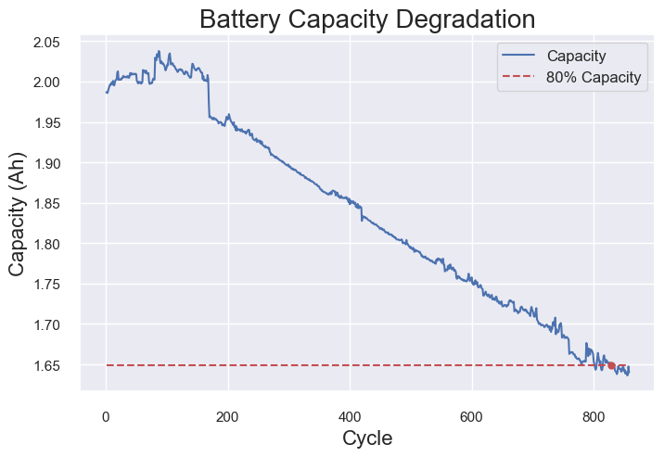
Dataset 1: 18650
Data in Dataset (Battery 1):
Only Charging Curve
Battery Charging Curves
(1 cycle)
Capacity Degradation Curve
25 / 45

Slide 26
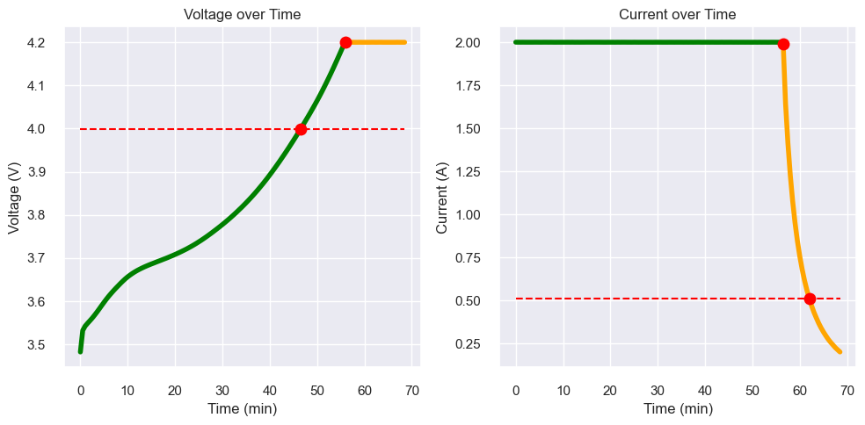



Dataset 1: 18650
Step1: Data Processing
CC Voltage
CV Current
CC
Voltage
Range
CC -> U: 4.0 ~ 4.2V
CV -> I: 2.0 ~ 0.5A
Sample points number
CC Voltage: 20
CV Current: 10
CV Current
26 / 45

Slide 27




Dataset 1: 18650 – Capacity Prediction
Step2: CapaDeepNet
Battery 1: Training Data
(training and validation)
Battery 2 and 3: Evaluation
27 / 45

Slide 28




Dataset 1: 18650 – Capacity Prediction
Step2: CapaDeepNet
Battery 4: Training Data
(training and validation)
Battery 5 and 6: Evaluation
28 / 45

Slide 29






Dataset 1: 18650 – RUL Estimation
Step3: Time-window Linear Regression
Time-window
440-540 cycles
540-640 cycles
Battery 1
Battery 2
Battery 3
29 / 45

Slide 30






Dataset 1: 18650 – RUL Estimation
Step3: Time-window Linear Regression
Time-window
460-560 cycles
520-620 cycles
Battery 4
Battery 5
Battery 6
30 / 45

Slide 31








Dataset 2: 3633835
https://zenodo.org/records/3633835
Choose Battery: 25C05
(from 8 batteries)
Choose state V
Open-source; EIS Only
I
II
III
IV
V
VI
IX
Data source: Identifying degradation patterns of lithium ion batteries from impedance spectroscopy using machine learning
https://zenodo.org/records/3633835
31 / 45

Slide 32


Dataset 2: 3633835 – Capacity Prediction (Interval)
Choose Battery: 25C05
EIS Features (Method 1): Interval of Re/Im Segments
EIS Features
(for all cycles)
32 / 45

Slide 33



Dataset 2: 3633835 – Capacity Prediction (Interval)
Step2: CapaDNN
Capacity Degradation Curve
Prediction results
33 / 45

Slide 34


Dataset 2: 3633835 – Capacity Prediction (Characters)
Choose Battery: 25C05
EIS Features (Method 2): EIS Characters
EIS Characters
(for 1 cycle)
EIS Features
(for all cycles)
34 / 45

Slide 35

Dataset 2: 3633835 – Capacity Prediction (Characters)
Step2: CapaDNN
0.4308
0.91%
0.3170
0.78%
Capacity Degradation Curve
Prediction results
35 / 45

Slide 36
Dataset 2: 3633835 – Comparison
Step2: CapaDNN:
Mean Relative Error:
1.23% =====>>>>>> 0.78%
Method1: Interval
Method2: Characters
36 / 45

Slide 37





Dataset 2: 3633835 – RUL Estimation
Step 3:
Time-window Linear Regression
40–60 cycles
50–70 cycles
Model shows a poor Robustness!
60–80 cycles
70–90 cycles
37 / 45

Slide 38


Dataset 3: Button Cell
Self-measuring
Single Battery Only
Capacity Degradation Curve
EIS Profile
38 / 45

Slide 39


Dataset 3: Button Cell
Features
Charging Curve
Features
(for all cycles)
EIS Features
(for all cycles)
39 / 45

Slide 40







Dataset 3: Button Cell - Results
Step 3: Time-window Linear Regression
Step2: CapaDNN
40 / 45

Slide 41








Dataset 4: NASA (Deprecated)
Totally Ridiculous!
EIS Profiles for Several Batteries
41 / 45

Slide 42
Conclusion
To enhance the Accuracy and Applicability of our model,
For CapaDNN:
Good enough for LAB datasets
Collect more realistic data from REAL USAGE
For Time-window Linear Regression:
Effective for some cases
Poor Robustness
Sensitive to Abnormal value
42 / 45

Slide 43

System Demo
Demo Web
43 / 45

Slide 44
Reference
1．Wang, S., Jin, S., Bai, D., Fan, Y., Shi, H., & Fernandez, C. (2021). A critical review of improved deep learning methods for the remaining useful life prediction of lithium-ion batteries. Energy Reports, 7, 5562–5574. https://doi.org/10.1016/j.egyr.2021.08.182
2．Ansari, S., Ayob, A., Hossain Lipu, M. S., Hussain, A., & Saad, M. H. M. (2022). Remaining useful life prediction for lithium-ion battery storage system: A comprehensive review of methods, key factors, issues and future outlook. Energy Reports, 8, 12153–12185. https://doi.org/10.1016/j.egyr.2022.09.043
3．Wang, S., Jin, S., Deng, D., & Fernandez, C. (2021). A Critical Review of Online Battery Remaining Useful Lifetime Prediction Methods. Frontiers in Mechanical Engineering, 7. https://doi.org/10.3389/fmech.2021.719718
4．Park, K., Choi, Y., Choi, W. J., Ryu, H.-Y., & Kim, H. (2020). LSTM-Based Battery Remaining Useful Life Prediction With Multi-Channel Charging Profiles. IEEE Access, 8, 20786–20798. https://doi.org/10.1109/access.2020.2968939
5．Xu, Q., Wu, M., Khoo, E., Chen, Z., & Li, X. (2023). A Hybrid Ensemble Deep Learning Approach for Early Prediction of Battery Remaining Useful Life. IEEE/CAA Journal of Automatica Sinica, 10(1), 177–187.
https://doi.org/10.1109/jas.2023.123024
6．Lu, J., Xiong, R., Tian, J., Wang, C., & Sun, F. (2023). Deep learning to estimate lithium-ion battery state of health without additional degradation experiments. Nature Communications, 14(1). https://doi.org/10.1038/s41467-023-38458-w
7．Zhang, Y., Tang, Q., Zhang, Y., Wang, J., Stimming, U., & Lee, A. A. (2020). Identifying degradation patterns of lithium ion batteries from impedance spectroscopy using machine learning. Nature Communications, 11(1). https://doi.org/10.1038/s41467-020-15235-7

Slide 45
谢谢大家！ 请各位老师批评指正！

Slide 46








Appendix:
3633835 dataset
Capacity Degradation Curves
For 8 Batteries

